Slide 1
Commonly used 3D Terminology

Slide 2
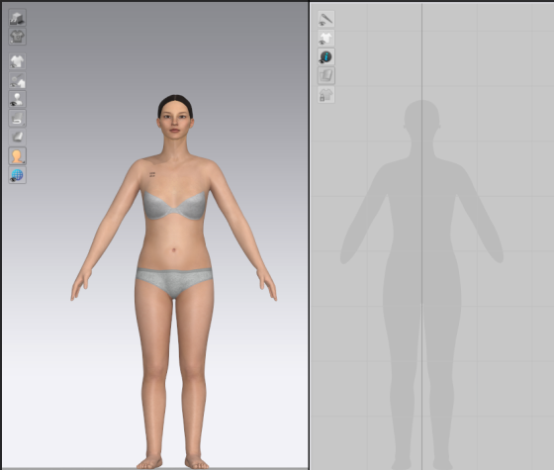
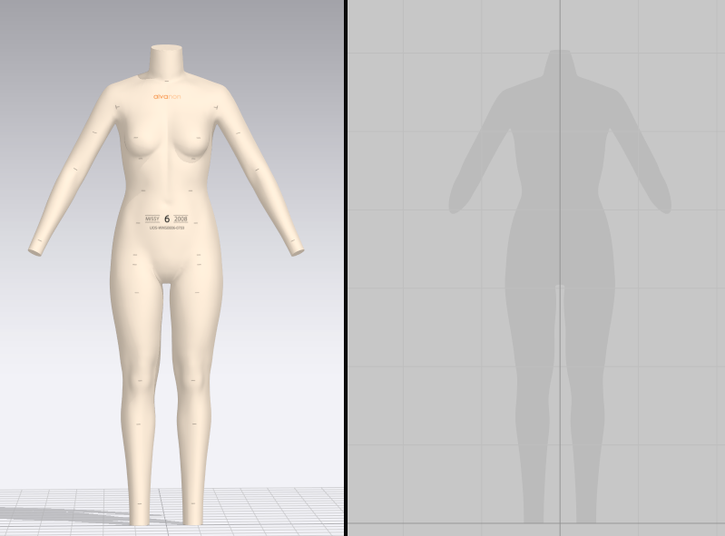
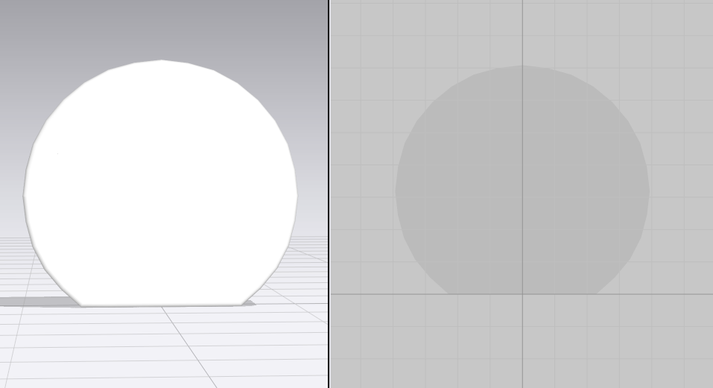
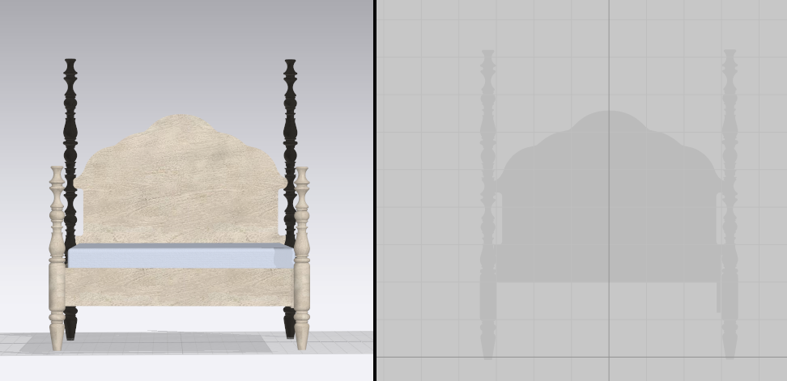
Avatar: Any Object you are draping fabric over in clo. Avatars will show up as gray shape in your 2D window.
Clo model
Alvanon Form – also know as a digital form
Shape
Bed Frame

Slide 3
Clo Program: CAD (computer aided design) program 3D virtual samples/patterns are created in
also capable to import/export objects (OBJ’s) and patterns (DXF)
pattern and style changes can be made, can render an image, can render annimation
Clo-Set: Web site for sharing project files - used to store, upload and download project files
can view tech pack, can render an image, cannot make any pattern or style changes
Virtual Sample = completed 3D style saved as a clo project file – format ZPRJ.
Virtual Fit = reviewing 3D style in clo-set or in clo program
Project File: .ZPRJ is file format clo projects are saved as
project files include all info associated with virtual sample.
pattern, fabric, colors, print file, avatar, trims, POM’s if added
OBJ: common object file format, object could be used as avatar or trim like a button
DXF: common file format for patterns. Most CAD pattern programs can open, export, and save as DXF format
Format extension needs to be DXF AAMA (DXF – drawing interchange format)

Slide 4
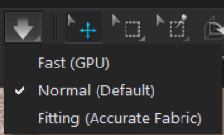
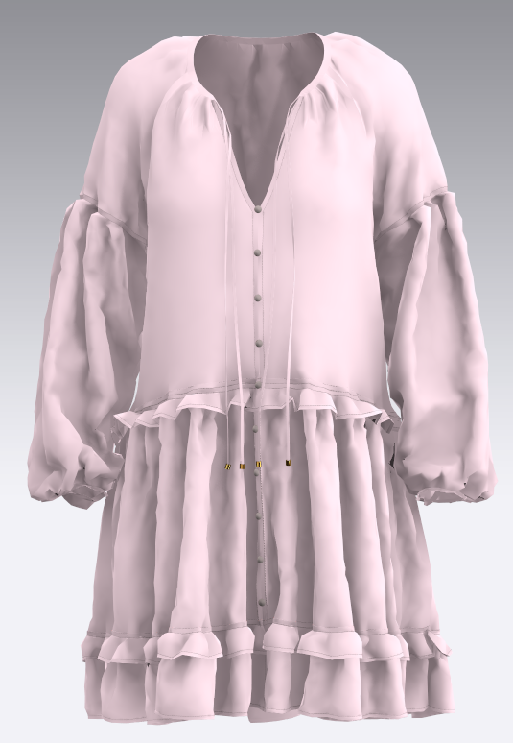
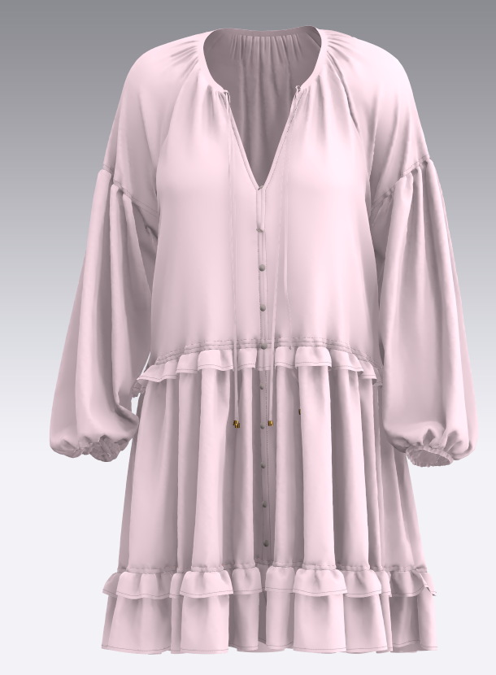
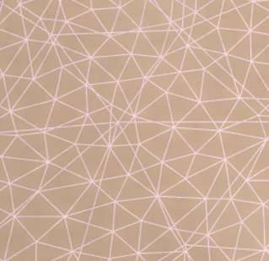
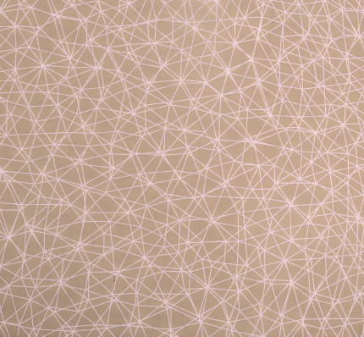
Simulation:
Use this function to apply gravity and drape Garment Patterns in the 3D Garment window. Pressing the Simulate button causes all Garment Patterns to fall towards the floor, and drape onto Avatars and similar objects that are in the way. When seamlines are set between Garment Patterns, the fabric drapes and falls while the set seamlines are sewn.
Particle distance: the resolution of the fabric either high or low.
low res shows less detail in drape and will simulate faster, high res shows more detail in drape and will complete simulation at slower pace
Tools
off
on
Toggles between high/low fabric resolution

Slide 5
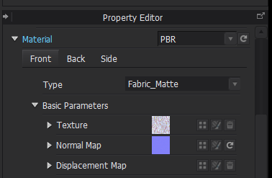
Digital Fabric: .Zfab file - Fabric file used to add fabric in clo
3 components are needed for digital fabric: Color/Print, Surface (woven, knit, pile, leather), Drape (fabric properties)
Tested fabric: Must be tested by using our clo fabric test kit: defines Fabric properties - warp, weft, and bias strips are weighed, thickness is measured, stretch and bend are measured. Collected data is computed to create the fabric properties or .Zfab file.
Fabric Scan: used to create look of surface - Fabric is photographed or scanned in on scanner with ruler on two sides for scale. This is used to create a normal map and in some cases will also be used for color.
Texture: Easier to think of as surface color or print. Add Print files to texture tab
Normal map: gives the digital fabric visual effect of being knit, woven, pile, or leather
Displacement map: used for fabrics with embossing, corduroy, embroidery, jacquards, or burnout velvets - adds more shadows and depth on fabrics with varied thickness
Material tab in clo has two choices:
PBR – (Physically Based Render) normal map is created in photo shop or extex from photo or scan of physical fabric
Substance – normal map is created in adobe substance. We have this option now as of 3-24-21. This option should be used for fabrics with varied
thickness.

Slide 6
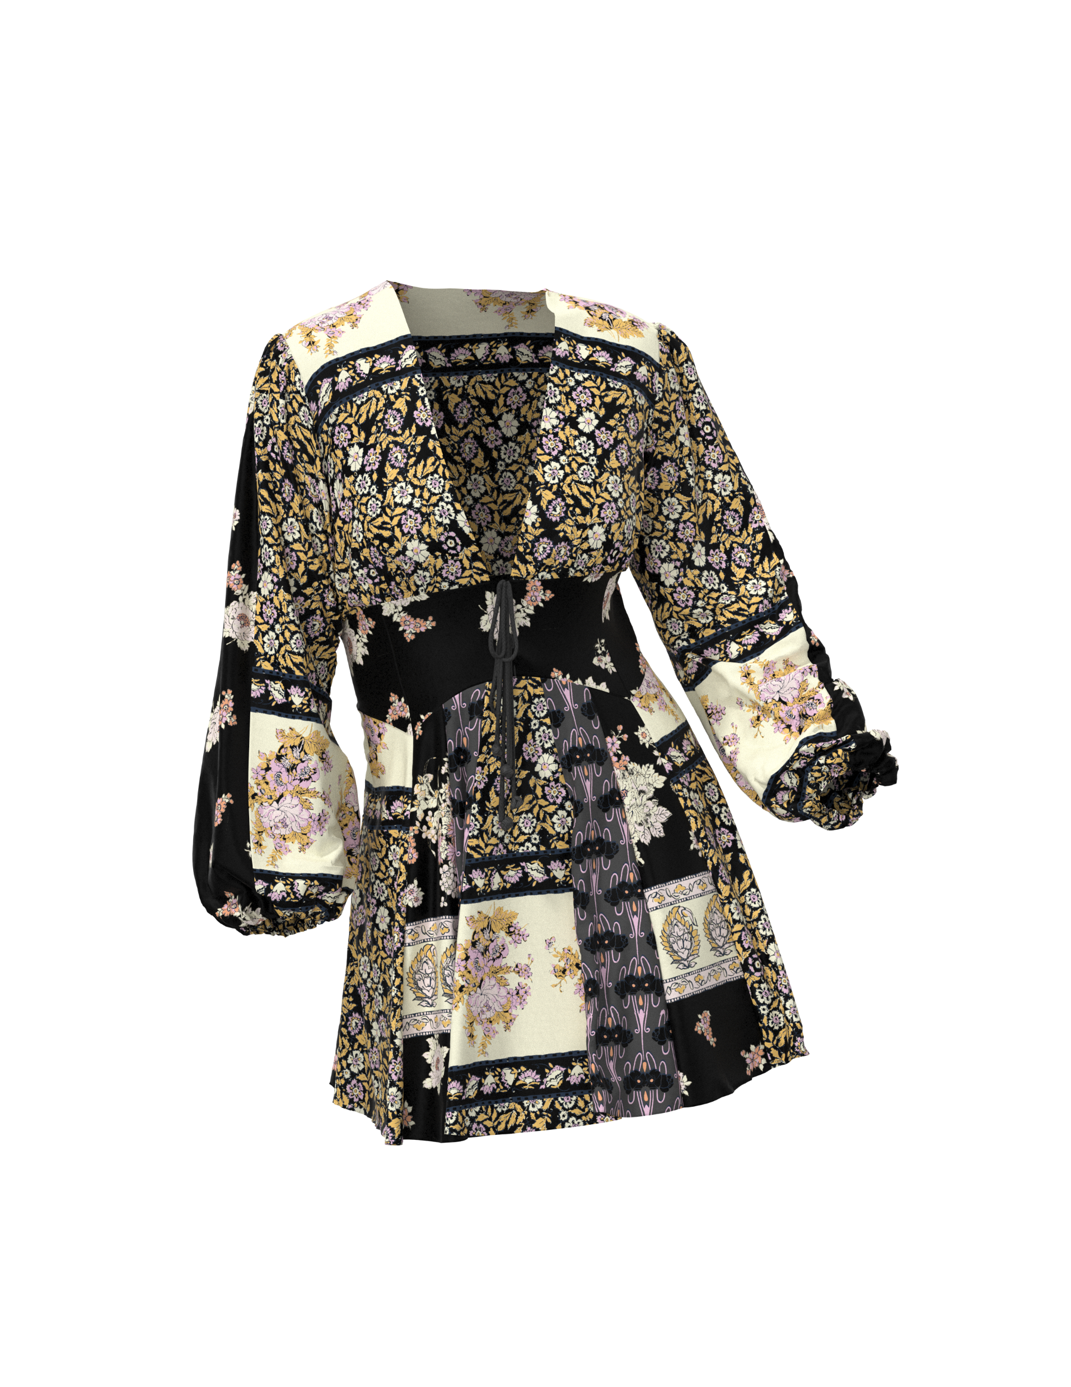
Render: term used in 3D meaning computer is generating an image with light and shadows to show depth like a camera does in photography
Presentation Posed Render: Composite Image of 2D photograph with 3D rendered garment photo shopped over
Render Examples
Image Examples
Hollow or Ghost Render in HDR
Model Photograph
3D mock shown from snapshot – quick image save from screen view
3D sample shown from snapshot – quick image save from screen view
3D render – Low quality render - image created with light to show dimension – run time 2 – 5 min.
3D posed render - image created in high quality increased light nuances – run time 15 – 30 min. (HDR - high definition render)

Slide 7
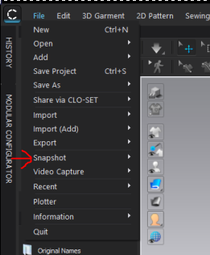
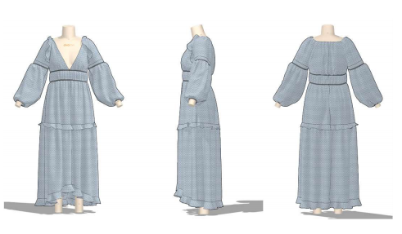
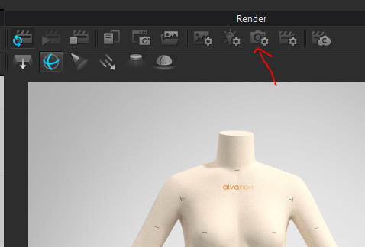
Snapshot: function in clo used to create front side back image of screen view from 2D window – will be in low quality
Rendered Snapshot: function in clo to capture screen shot of a low quality quick render in 3D window

Slide 8
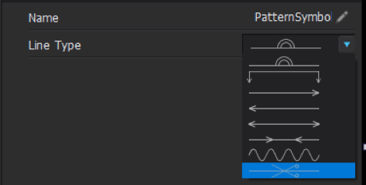
Annotation: Note written on pattern piece can include piece info or instruction – this will only show in CAD program
Piece name: Piece name – when TP is open this is name that will be seen
POM: Point of Measure
Pattern symbols:
Open symmetric – used at CF or CB line
Used when sending half piece
Fold line – used for cuff or placket
Directional arrows – most commonly used for pleat direction
Snake line used to denote shirring
Cut line

